Slide 1
User-focused tailor-made weather and climate services driving the climate/ early warning information value chain
Design and delivery of tailor-made services to facilitate Forecast based Actions (FbAs)
At the Community Level in Bangladesh – Lessons from Northwest Bangladesh
Raihanul Haque Khan,
RIMES

Slide 2
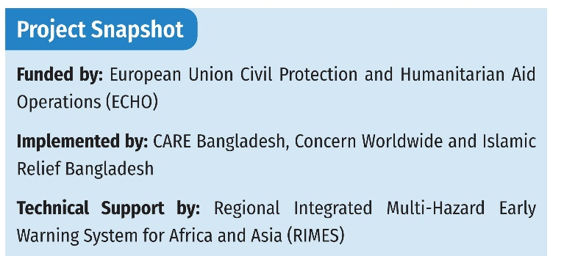
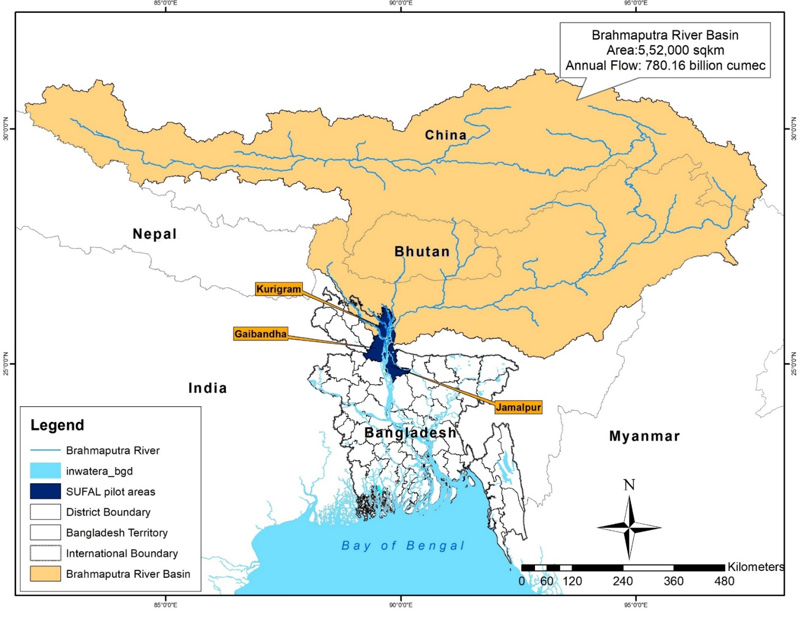
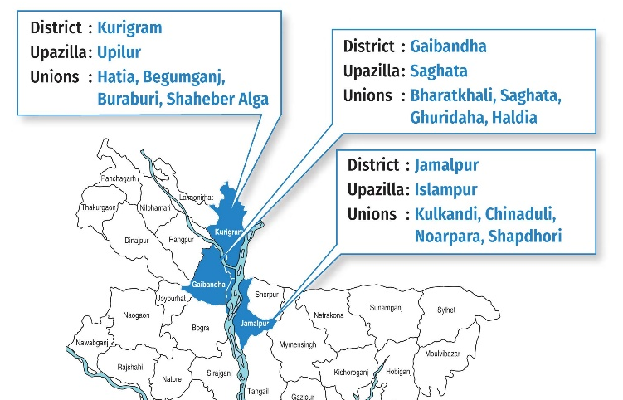






Background: Supporting Flood Forecast Based Early Action and Learning (SUFAL)

Slide 3
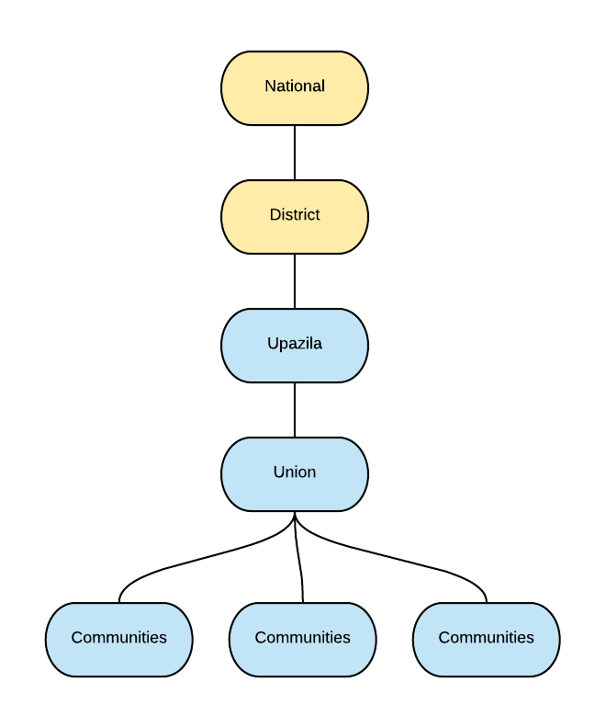






Institutional Arrangement
01
Flood Forecasting and Warning Center
02 Department of Disaster
Management
04
Disaster Management Committees
03
Local Government Institutes
Monsoon Flood
Standard operating procedure
Focus on broader aspects of FBA
Strengthening dissemination mechanism
Integration with the govt. system

Slide 4
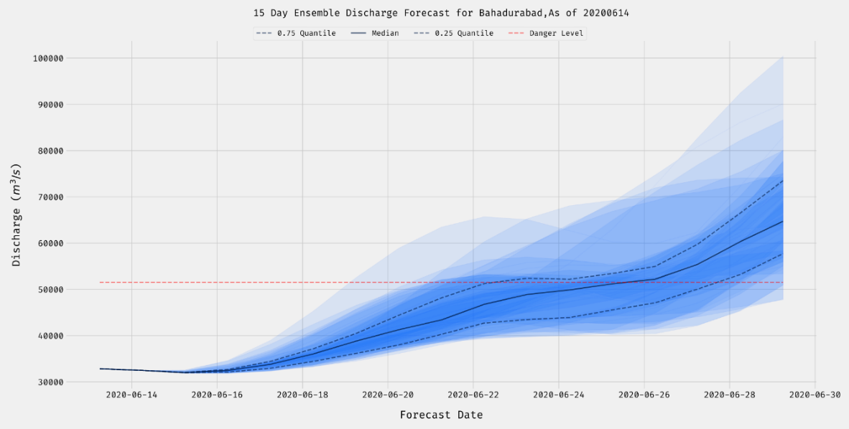
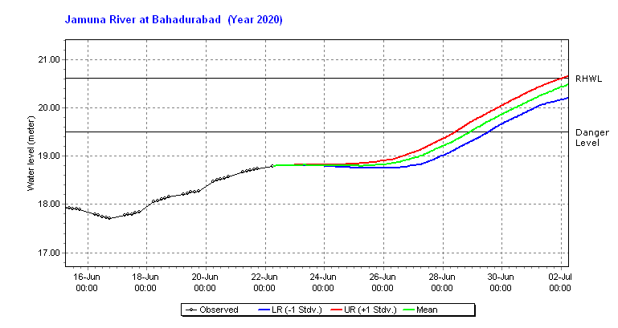
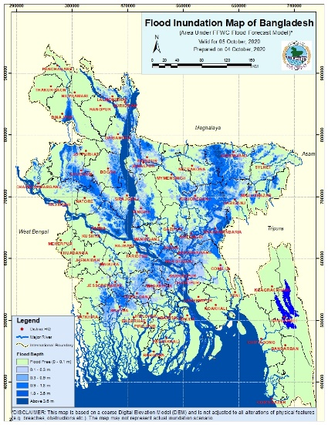
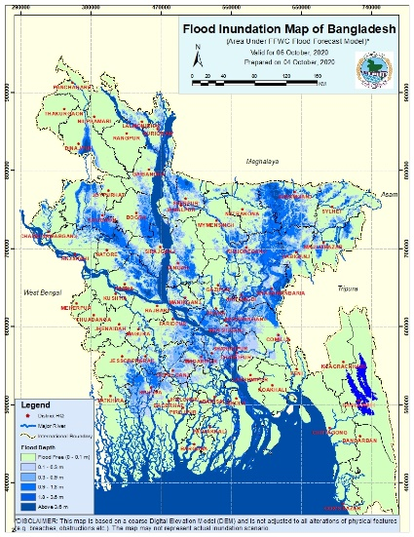
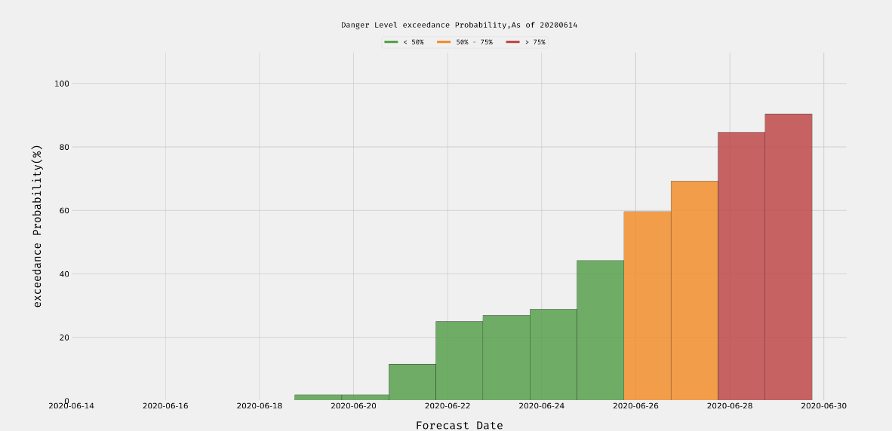
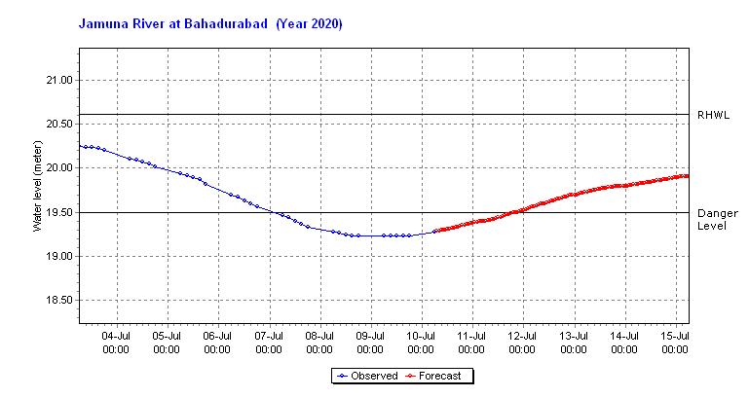
Available Forecast Products
15 days probabilistic streamflow forecast
10 days probabilistic, 5 days deterministic forecast
Inundation Forecast
www.ffwc.gov.bd

Slide 5

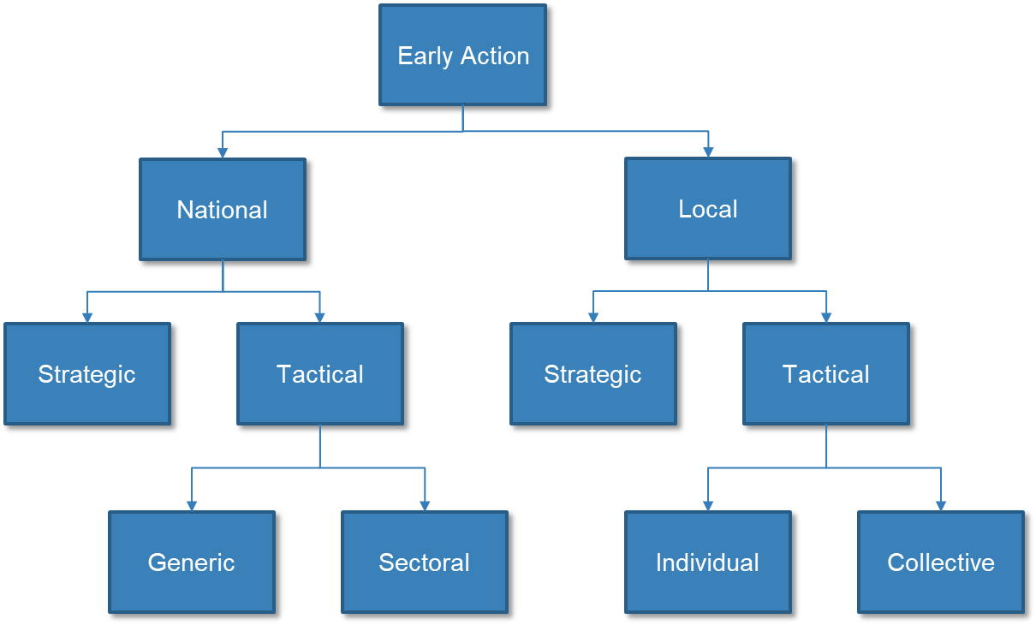
Expected Magnitude
Impact
Anticipation to Action: The Early Action Matrix
Expected Duration
Timing of Flood
Threshold Exceedance
18
Below DL within 50 cm | Warning Level
At and Above DL up to 1m | Flood
More than 1m above DL | Severe Flood
TRIGGER
17
16
Danger Level
1m
15
14

Slide 6



Anticipation to Action: The Early Action Matrix
Institutional Level
Community Level
Forecast Trend Danger Level | Decreasing | Increasing
More than 1m above Danger Level
At danger level and Up to 1m above Danger Level
Within 1m below Danger Level |  | >75% Probability of Danger Level Exceedance
 |  | <75% Probability of Danger Level Exceedance
Lead time Early Actions | 1-3 Days | 3-5 Days | 5-7 Days | 7-10 Days | 10 – 15 days
How to respond to EW, how better utilize financing
EWM
Forecaster
Disaster management & Humanitarian
Expected duration, impact, forecast consistency, rate of increase, time to peak
Danger Levels!

Slide 7
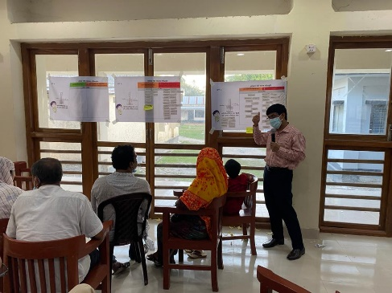
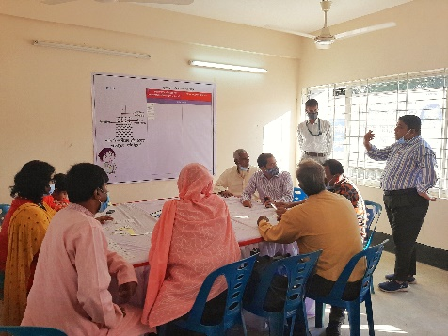
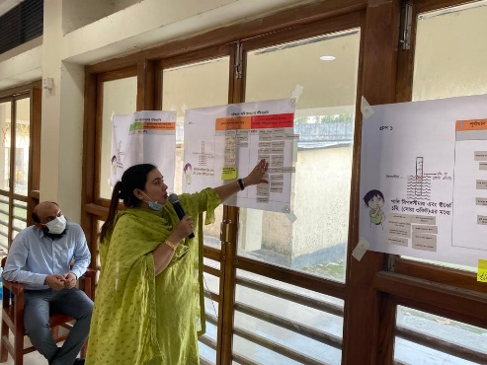
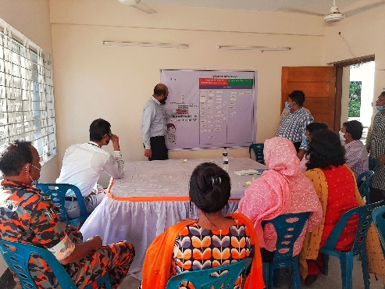
Anticipation to Action: The Early Action Matrix
Example: Institutional Level Matrix SOP
Forecast Trend Danger Level | Decreasing | Increasing
More than 1m above Danger Level | Monitor Flood Forecast, Emergency Medicine Distribution, Special Advisory from Agriculture, Livestock, Fisheries and Public Health department, Water purification tablet distribution; | Multi-purpose cash grant, Disaster Management Committee Meeting, Prepare new flood shelters, Early Warning Dissemination, Ensure safety and security of women and children at shelters;
Within 1m below Danger Level | Monitor Flood Forecast, Special Advisory from Agriculture, Livestock, Fisheries; Repair embankments/roads, vaccinate livestock, instruction to leave flood shelter; | >75% Probability of Danger Level Exceedance Disaster Management Committee Meeting, Repairing evacuation routes, Early Warning Dissemination, Multi-purpose cash grant, Shelter preparation, evacuate families at risk;
 |  | <75% Probability of Danger Level Exceedance Shelter preparation, Water purification tablet storage, store disinfectant and anti-venom, vaccinate livestock, Volunteer and Medical Team, prepare evacuation boats;

Slide 8

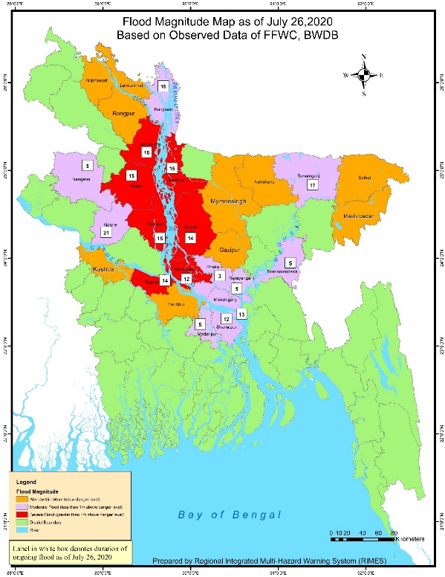
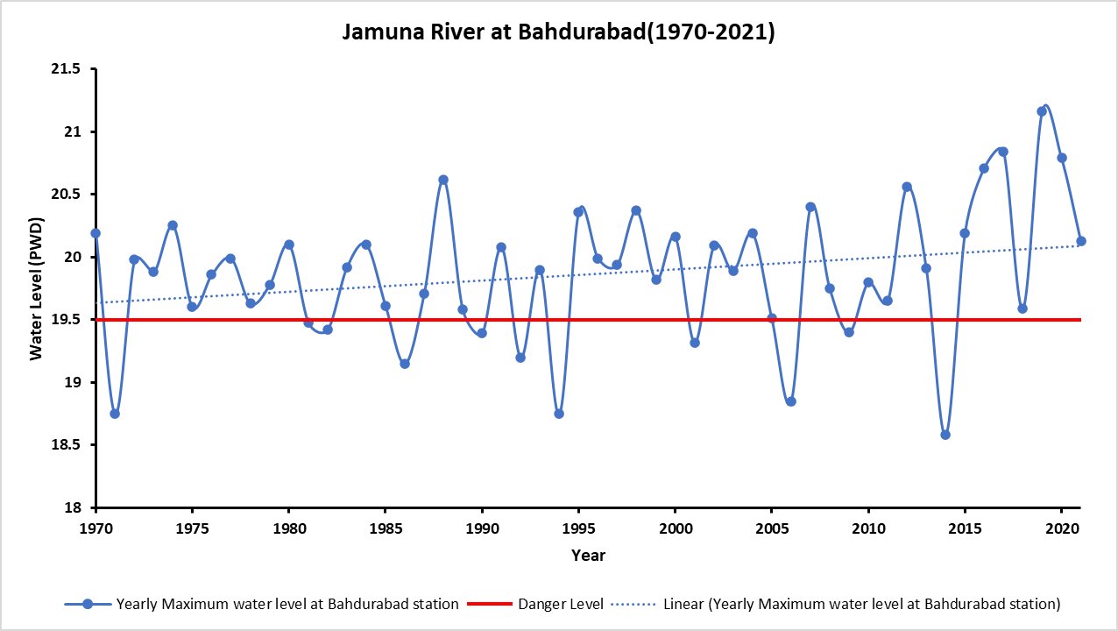
Longest flood in the last 22 years
Monsoon Flood 2020
Around 5.5 million people affected
37% of the country inundated
41 people lost their lives
Monsoon 2020
USD 74.5 million worth of livestock damaged
3,745 hectares of land eroded
USD 42 million worth crops damaged
125,549 hectares of agriculture land damaged
Source: Department of Disaster Management
Intensity and Frequency of floods are increasing alarmingly!

Slide 9
Piloting Early Action Matrix Amidst COVID-19
Modified Matrix Considering COVID Context
Type of Action | Early Action
Level 1 Early Actions Can be taken at 50-60% probability of flood occurring | Provision of protective gear for DMCs and volunteers (COVID19 considerations) Preparation of general advisory on forecast and flood risk for households Dissemination of forecast and early warning information to community Checking and repair of hand-held / mobile loudspeakers, volunteer support, renting van Listing most vulnerable households for MPCG (Cross-check list of VGD/VGF); selection criteria: poverty level, household location, gender/inclusion, Agri/WASH/health Listing most vulnerable households for evacuation and other support Preparation of flood shelters and evacuation points (repair rooms, WASH facilities, electric supply, with provisions for gender and special needs, COVID19 considerations) Repair damage to access roads, evacuation routes and embankments (Coordination with BWDB and using indegeneous knowledge), CfW for fixing roads, evacuation points Protection and repair of tube wells and toilets in common and large catchment areas (schools, flood shelters, evacuation points)
Level 2 Early Actions Can be taken at 75% probability of flood occurring and when at least 5 days flooding is expected | Multi-purpose cash grants (MPCG) to ultra-poor and poor households in flood forecasted zones (BDT 4,500)
 | Distribution of water container / tanks to households (20L/500L), water purification tablet, soap, ORS etc.
 | Evacuation support to most vulnerable households with women, children, elderly, persons with disability (e.g. provision of boats and trawlers) Arrangement of transportation in case of evacuation (boats, trawlers), Rent, fuel costs
 | Provision of face masks and/or first aid kits at shelters (Coordination with DoH and DPHE) depending on numbers of persons taking shelter at each point

Slide 10
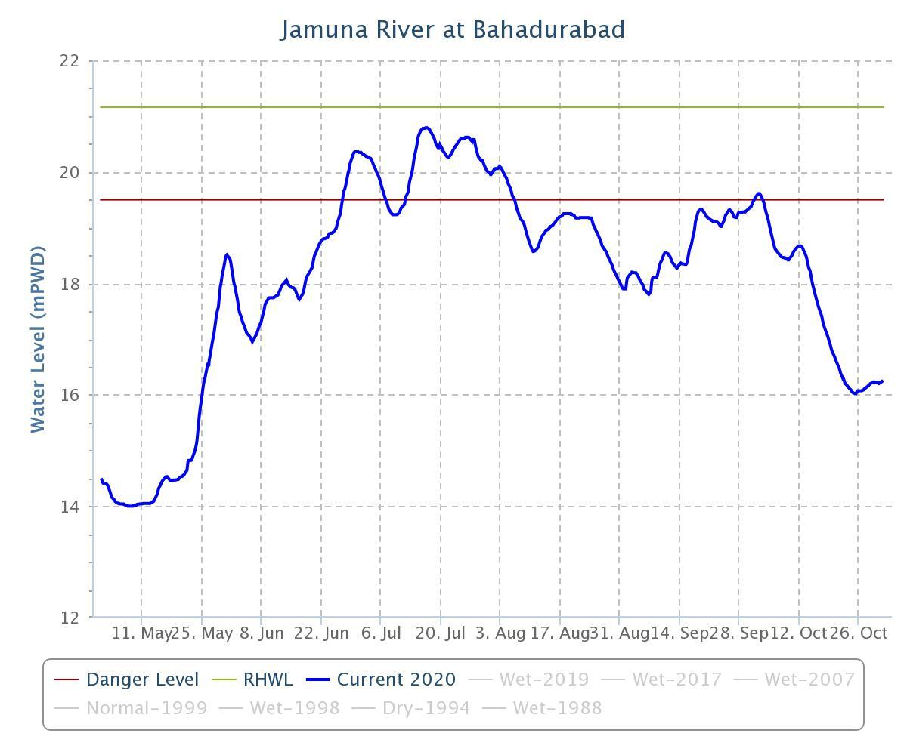

Piloting Early Action Matrix: Monsoon 2020 Amidst COVID-19
Trigger 2 activated
Jun 14, Flood event in Brahmaputra basin detected
Jun 16, Local level flood forecast bulletin issued, Trigger 1 Activated
June 21, Local level flood warning issued, Trigger 2 Activated
June 28 – July 6, flood continued max WL remained within 1m above DL
July 9, Trigger 2 reactivated, max WL exceeded 1m above DL around end of July
Trigger 2 reactivated
Trigger 1 activated
Communicated through FFWC’s email and SUFAL voice broadcasting system

Slide 11
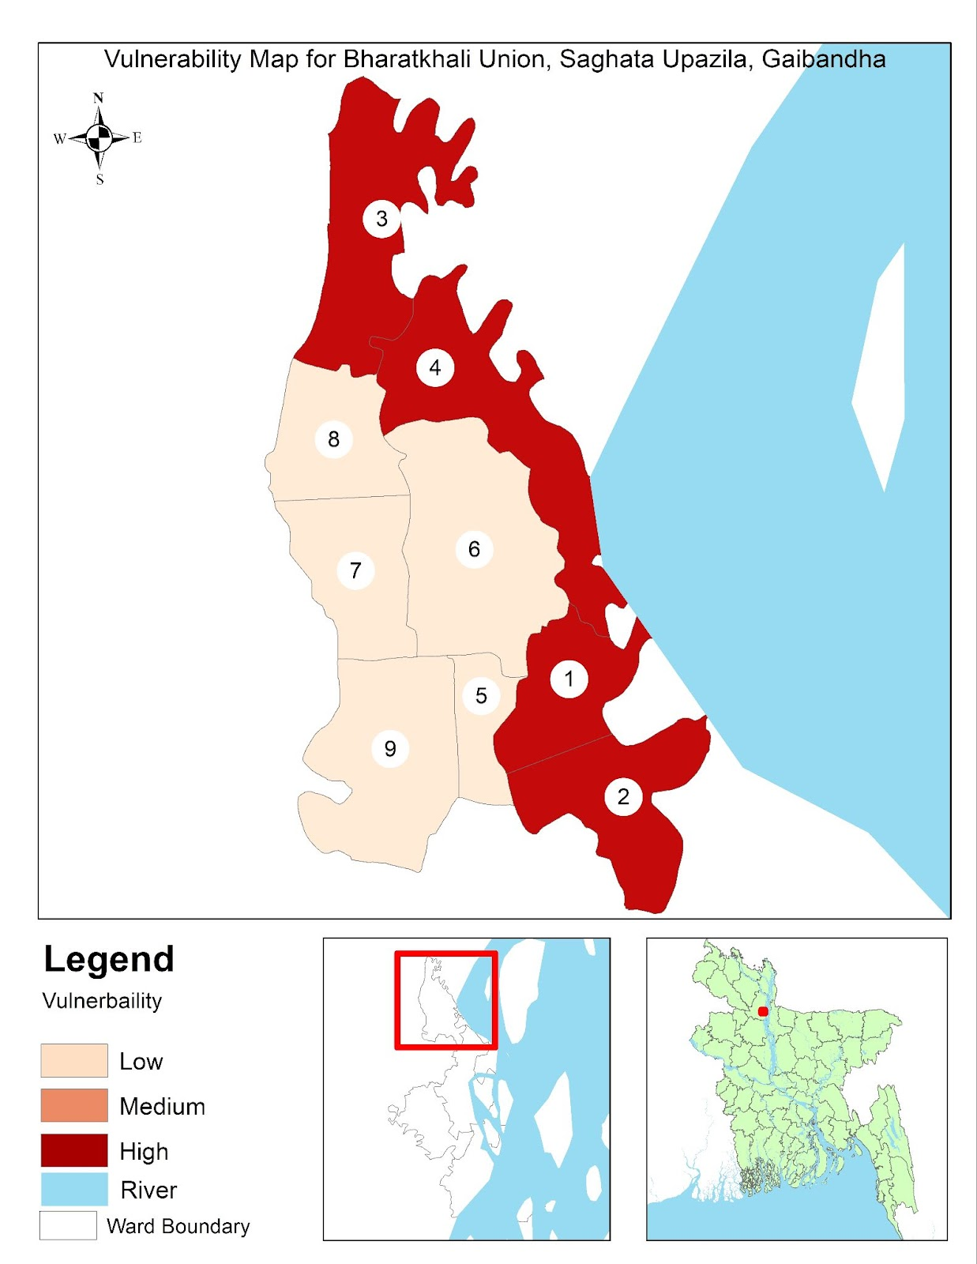
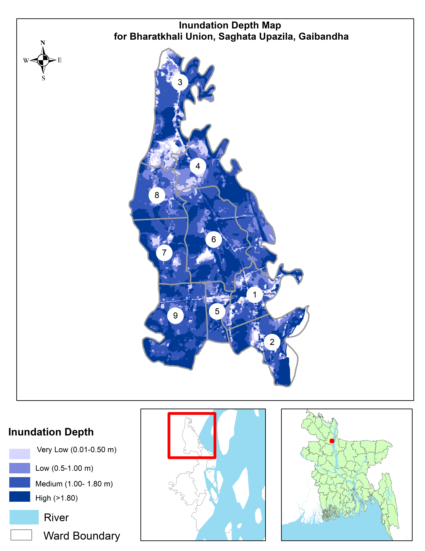
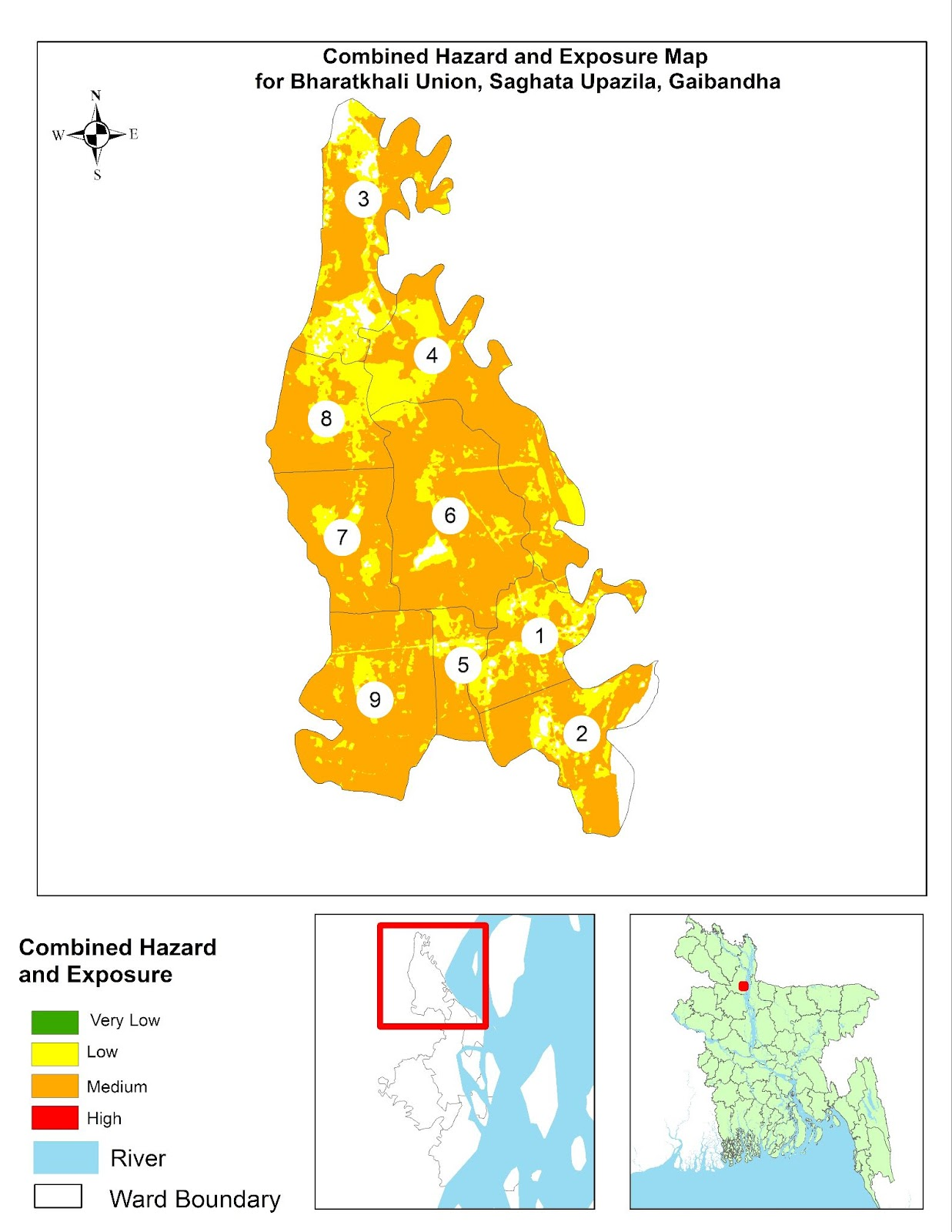
Assessing the Risk

Slide 12
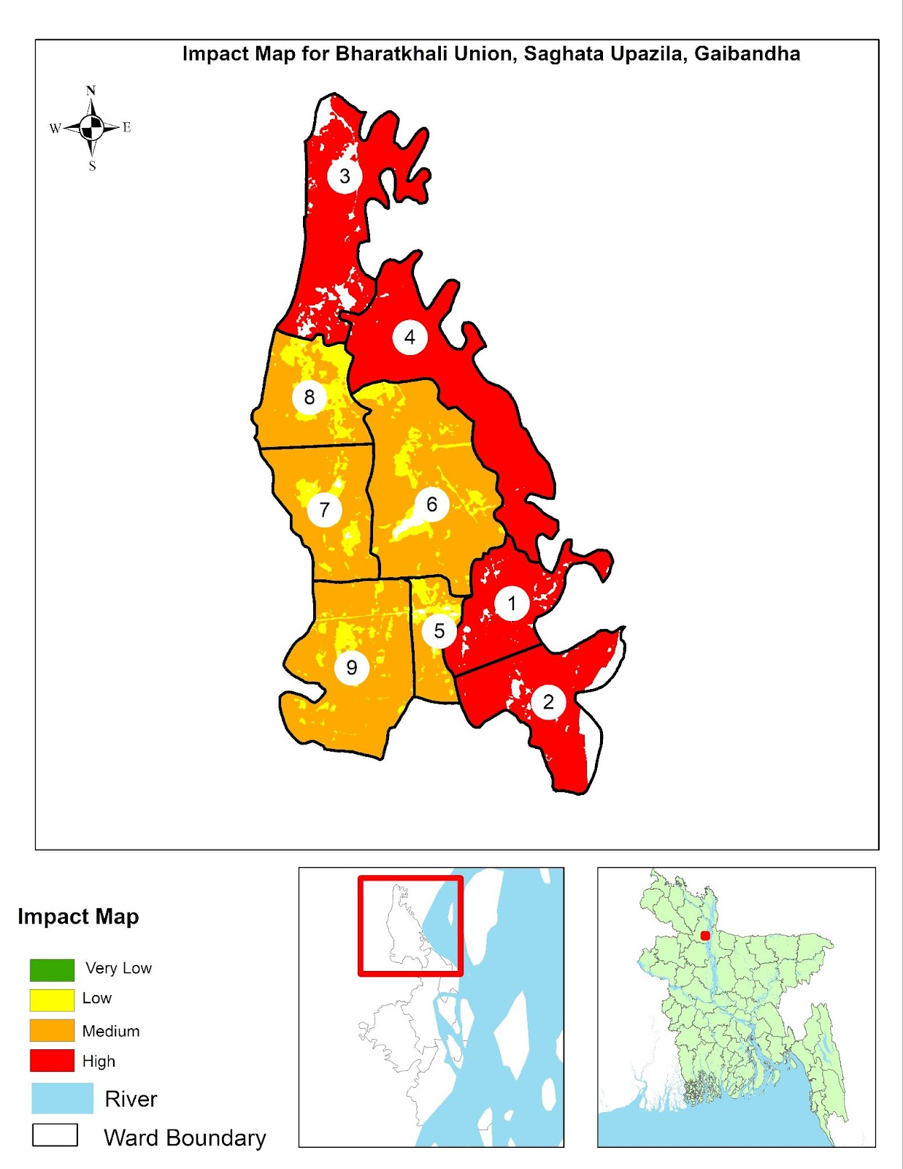
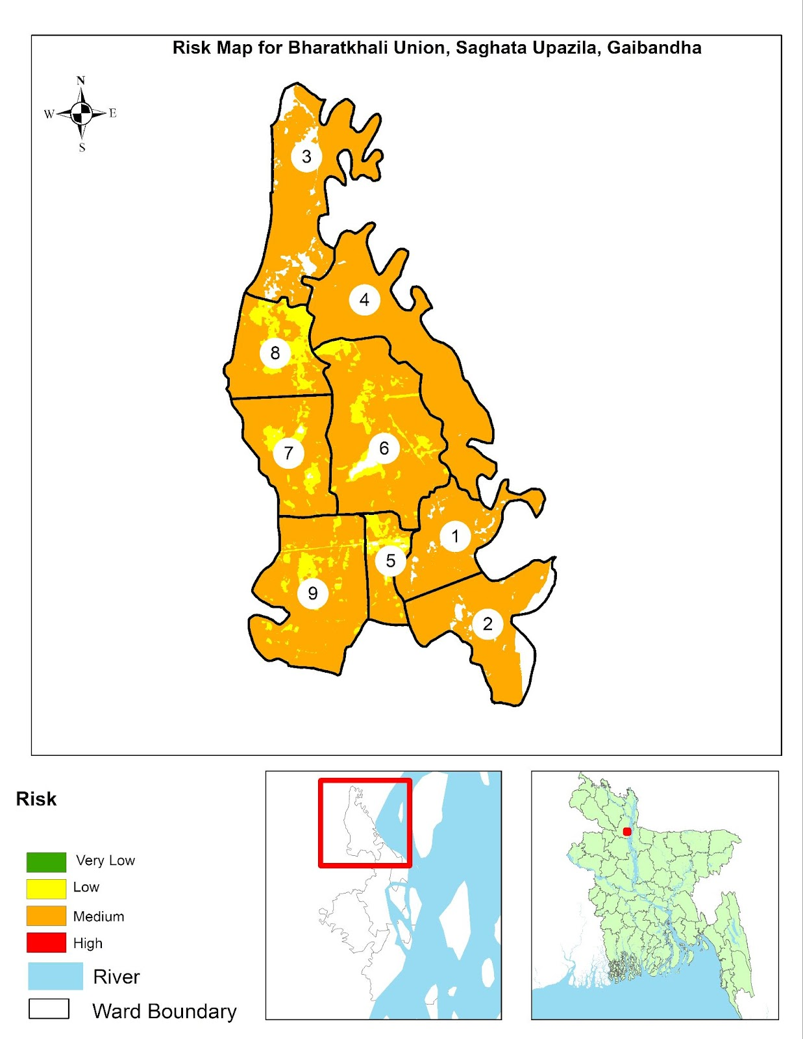
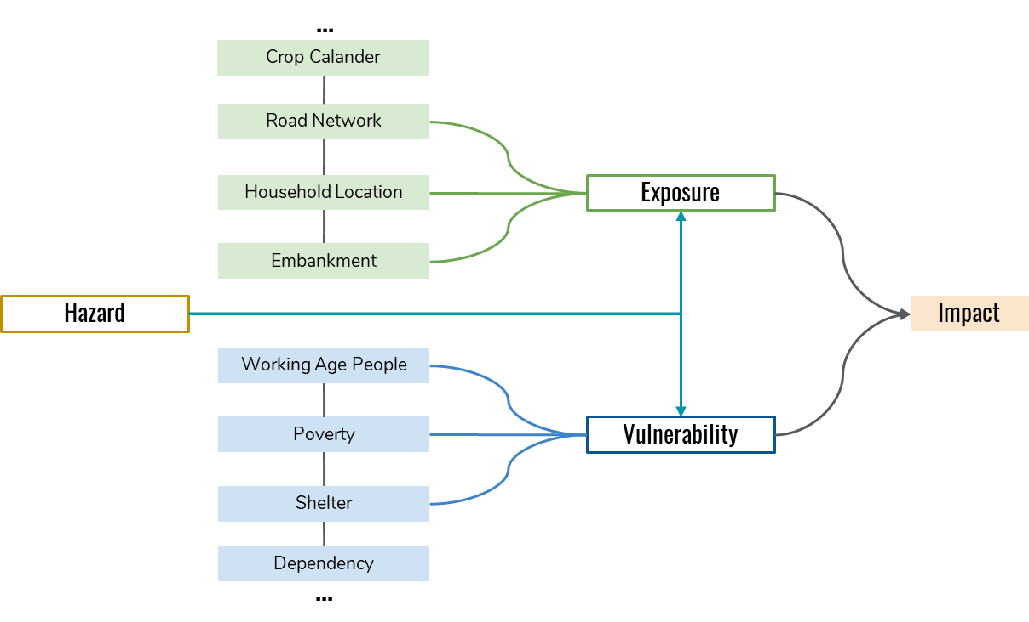
Assessing the Risk

Slide 13
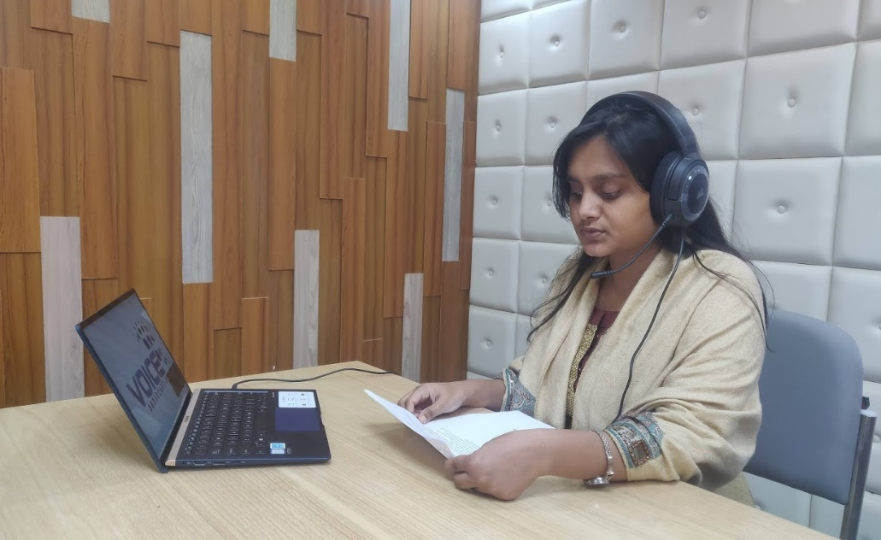
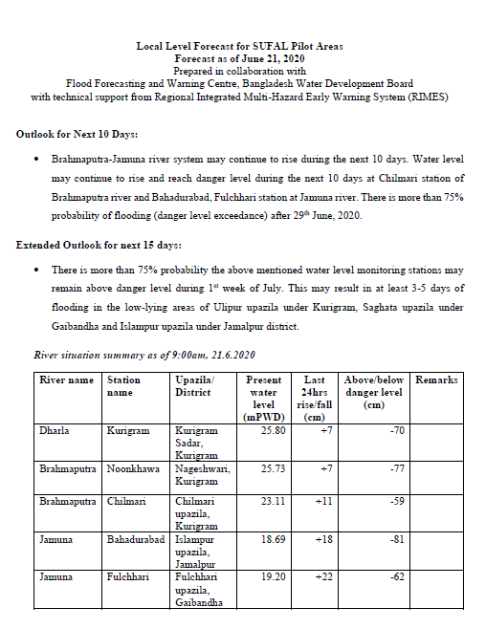
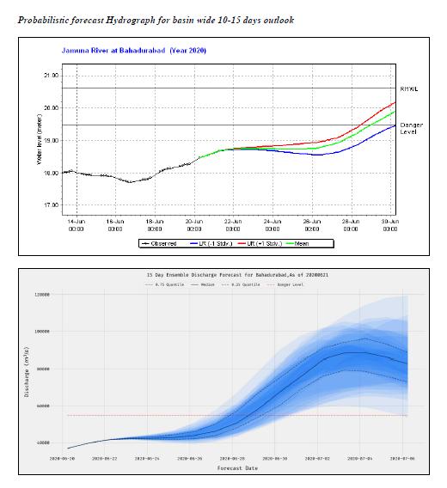

Local Level Flood Forecast Dissemination
Establishment of two new river gauge
  Hatia station in Brahmaputra at Ulipur Upazila, Kurigram
  Saghatta station in Jamuna at Saghatta Upazila, Gaibandha
39,729 households of the project area, 97% received early warning messages
© RIMES

Slide 14
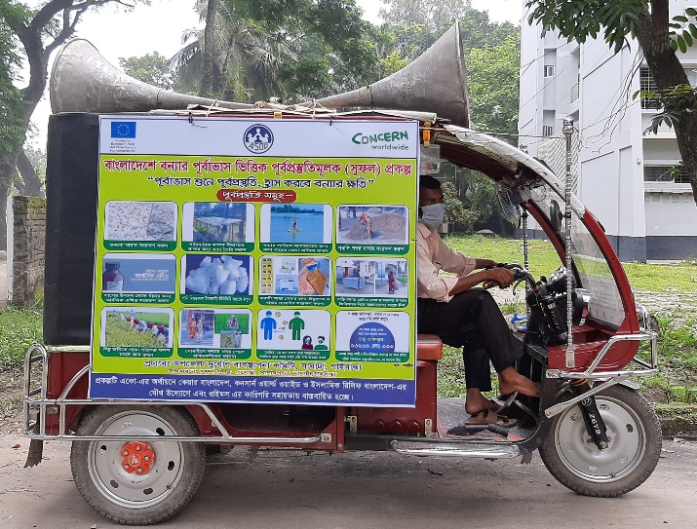
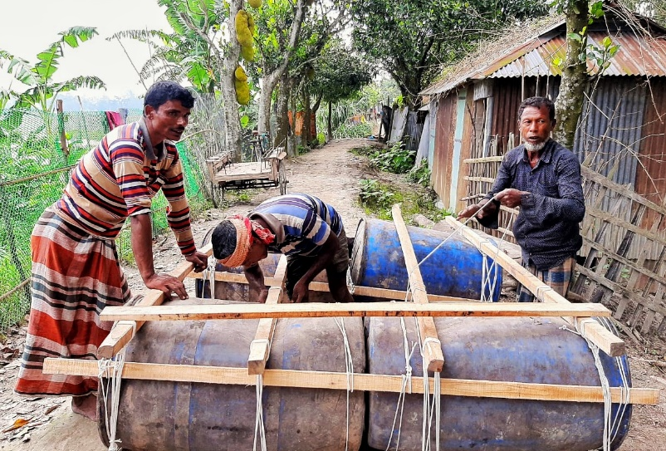
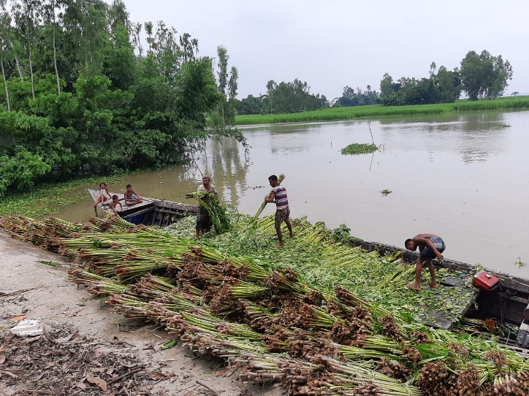
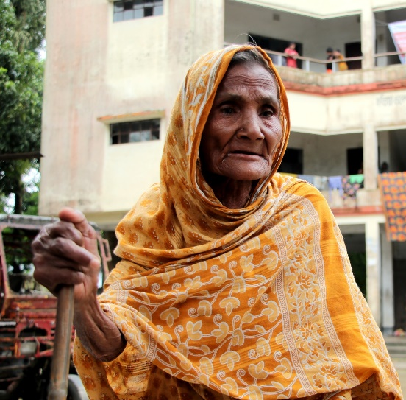
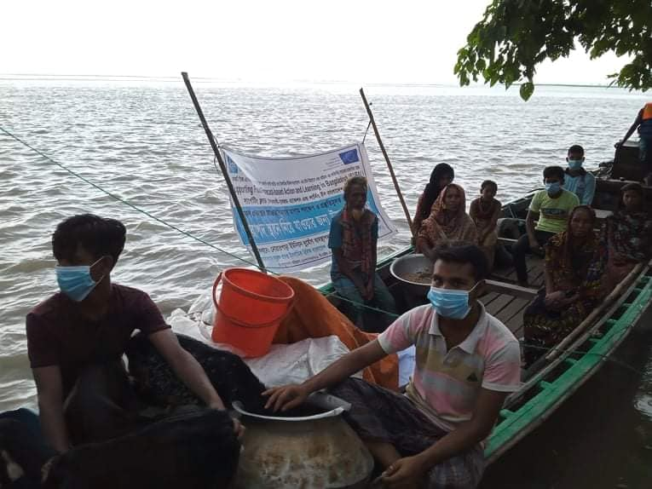
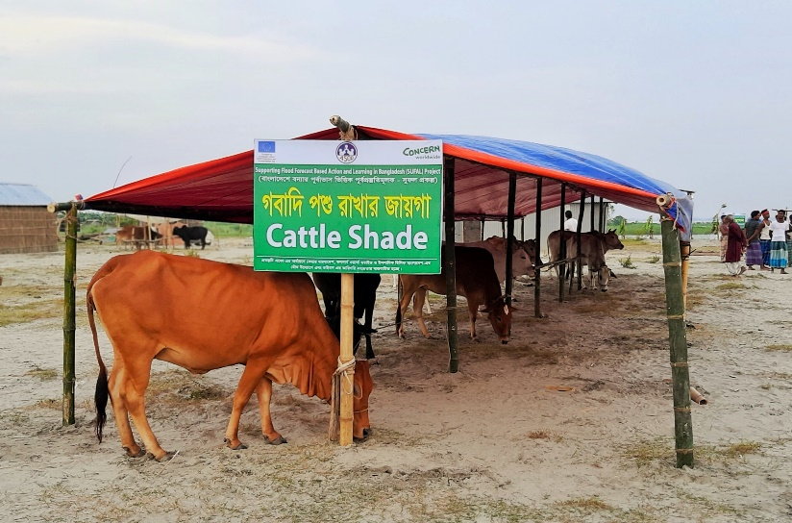
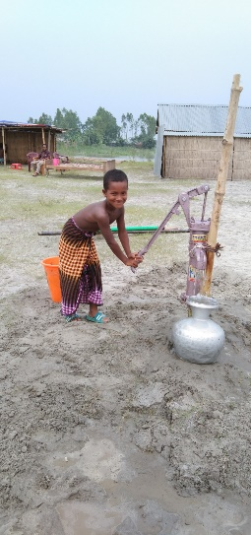
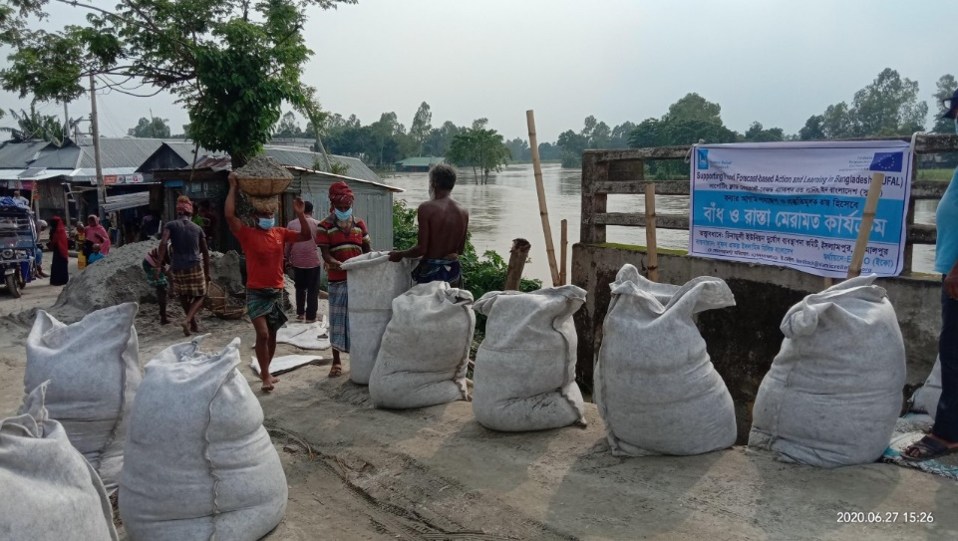
Monsoon 2020: Early Action
Photo Credit: SUFAL Project

Slide 15



Post Monsoon Assessment 2020: Community Response to Advisories
Livestock
Fisheries
Livestock
Household
367 Euro
193 Euro
236 Euro
Additional support required at the community level for early action
Average savings per HH by taking early action in SUFAL project areas

Slide 16






Community Level Users
External Data Provider
06
01
feedback
Climate Information Value Chain
National Level Users
information
Private Sector
05
02
Research & Development Partners
In-Country Data Provider
04
03
Boundary
Org.
Sectoral Experts

Slide 17





Community Level Users
1
External Data Providers
External Data Provider
06
01
External Data Providers Global Producing Centers, Regional Climate Centers etc. For Example, European Center for Medium Range Weather Forecast (ECMWF), NOAA etc. Strenghthen NHMS with value added data.
National Level Users
05
02
In-Country Data
Provider
04
03
Boundary
Org.
Sectoral Experts
01

Slide 18
Community Level Users
External Data Provider
06
01
National Level Users
2
05
02
In-Country Data Provider
In-Country Data
Provider
National Hydromet Service Providers Production of tailored hydro-meteorological information based on the demand from the sectoral institutions/experts. In this case the information is produced by Flood Forecasting and Warning Center of Bangladesh Water Development Board.
04
03
Boundary
Org.
Sectoral Experts
01

Slide 19
Community Level Users
External Data Provider
06
01
National Level Users
Sectoral Experts co-produces tailored sector specific advisory services based on tailored hydrometeorological information considering the demand of the end users from National down to local level. In this case Department of Disaster Management, Department of Agricultural Extension, Department of Livestock Services etc.
05
02
In-Country Data
Provider
04
03
3
Sectoral Experts
Boundary
Org.
Boundary
Org.
Sectoral Experts
01

Slide 20
Community Level Users
External Data Provider
06
01
Boundary Organizations Two-way Communication of climate information and advisory services. For example, Disaster Management Committees, Extension Workers, NGOs, CBOs etc.
National Level Users
05
02
In-Country Data
Provider
04
03
Boundary Organisations
4
Boundary
Org.
Sectoral Experts
01

Slide 21
National/Sub-National Users Contributes in co-production, assess user demand, uses information at decision making and provides feedback. For example, Humanitarian Workers, Development Planners, Disaster Managers, Public Health, private sector etc.
Community Level Users
External Data Provider
06
01
5
National Level Users
National/Sub-National Users
05
02
In-Country Data
Provider
04
03
Boundary
Org.
Sectoral Experts
01

Slide 22
Community Level Users
6
Community Level Users
External Data Provider
06
01
Community Level users blend in indigenous knowledge with tailormade information to reduce risk and optimize resource management. Farmers, Vulnerable Communities etc.
National Level Users
05
02
In-Country Data
Provider
04
03
Boundary
Org.
Sectoral Experts
01

Slide 23

Community Level Users
External Data Provider
06
01
feedback
Climate Information Value Chain
National Level Users
information
Private Sector
05
02
Research & Development Partners
In-Country Data Provider
04
03
Boundary
Org.
Sectoral Experts

Slide 24
KEY LESSONS IDENTIFIED
Scenario-based Triggers Works Well
Traditional forecast based financing single triggers cannot capture the overall spectrum of Forecast Based Action (FBA). Scenario based triggers works well in case of multiple peaks/frequent floods in single season. However, capacity is needed to interpret and communicated the triggers. The triggers are not automated, a human layer is needed.
FBA for Community Resilience
FBA not only helps to avoid losses and minimize risks but also let communities save their productive assets, input costs that in turn contributes to long-term community resilience.
Strengthening Stakeholder Engagement and Coordination
Coordination with NHMS, DMA and sectoral institutions is ever so important. There is need for interfacing platforms and or decision support systems and standard operating procedures. There is need for regular dialogues, trainings and outreach programs. Capacity of the stakeholders and communities need to be enhanced for translating forecast into proactive ex-ante actions.
Need for longer lead time and Impact Based Forecasts
For better preparedness and anticipatory actions a combination of short, medium range and longer lead time forecast is required. Longer lead time is required to take strategic moves for anticipatory actions e.g. resource mobilization. Impact based forecasts need to be scaled up and operationalized for better anticipation of risks and pinpoint where actions are needed most.

Slide 25
KEY LESSONS IDENTIFIED
Additional support required for the community
Although the forecast based advisories can significantly reduce losses, minimize risks; in order to maximize the benefits from these services, additional support, resource availability/mobilization should be ensured in the broader spectrum of Forecast Based Action (FBA). For example, only cash grants may not be useful for the farmers during the anticipatory window if there is fodder crisis in the locality.
Demand for two-way communication
The project developed a voice message broadcasting platform which has been used as the key channel for dissemination. This is one way broadcasting system. However, it was revealed from local level assessment that communities do not only want to listen to the advisories but also ask further case specific questions. An umbrella call center for climate services, through an interfacing agency can be developed in future to cater this need.
Further action required for women
While mobile services can improve the information delivery significantly, there are still challenges with advisory service delivery to the women. Although the project provided information to women groups, further action required to ensure women are equally informed. Women have been found to be more proactive in listening to and adhering to advisories in some cases.

Slide 26

Thank you!
PROGRAM TO SUPPORT SOUTH ASIA REGIONAL DEVELOPMENT IN OPERATIONAL FORECASTING AND SERVICE DELIVERY
SAHF Website: https://sahf3event.rimes.int/
YouTube Broadcast:
https://youtu.be/QAAf326wP00

