Slide 1
User-focused tailor-made weather and climate services driving the climate/ early warning information value chain
Benefits of Climate Information Services to National Economy: rationale for investing on NMHSs
a study by
National Council of Applied Economic Research
Dr Parvinder Maini
Ministry of Earth Sciences, Govt of India

Slide 2
Ministry of Earth Sciences
Vision
To excel as knowledge and technology enterprise in realm of Earth System Science for socio-economic benefit of the society
Mission
To provide services for weather, climate, ocean and coastal state, hydrology, seismology and natural hazards; to explore and harness marine living and non-living resources in a sustainable manner and to explore the three poles of the Earth (Arctic, Antarctic and Himalayas)

Slide 3
Over the years Considerable Investments made in improving weather, marine and other hazard related services
While the costs of rendering these services is quantifiable through the Ministry's budget but the societal benefit of these services in quantifiable terms can be known only through third party evaluation and through specific studies designed for the purpose.
Third party evaluation serves many purposes
constructive feedback about the services being rendered, thereby helps in improving the service
(ii) helps to understand and narrow the gap between information being provided and the information being sought by the end user
(iii) the impact of the service in economic terms.

Slide 4
National Council of Applied Economic Research (NCAER) a non-profit research institution
Phase-I : 2010 Economic benefits of (i) Agromet Advisory Service (ii) Fishery services (iii) Early warning of Hazards (cyclone, tsunami, floods) (iv) Public weather Service
- Only 24% of Farmers aware of AAS
Economic Benefit ~500 billion
- 90% of fishers aware of the service
Economic Benefit ~340 billion
Phase-II- 2012 Economic benefits (i) Aviation Services (ii) Desalination Plant (iii) Ornamental Fish (iv) Fattening of Crab & Lobster
Phase-III – 2015 : Economic Benefits of Dynamic Weather and Ocean Information and Advisory Services in India
In Phase-III, NCAER concluded
considerable improvement in the reliability of weather and climate service since 2010
3 times jump in the awareness of the service being rendered by MoES.
NCAER attributed this to increased reliability due to assimilation of more non-conventional data and higher resolution of the model, Timely dissemination through various modes, interface with NGO for awareness etc.
Pertinent to carry forward the study to see the Impact of Mission Mode programs initiated by MoES on weather and marine service

Slide 5
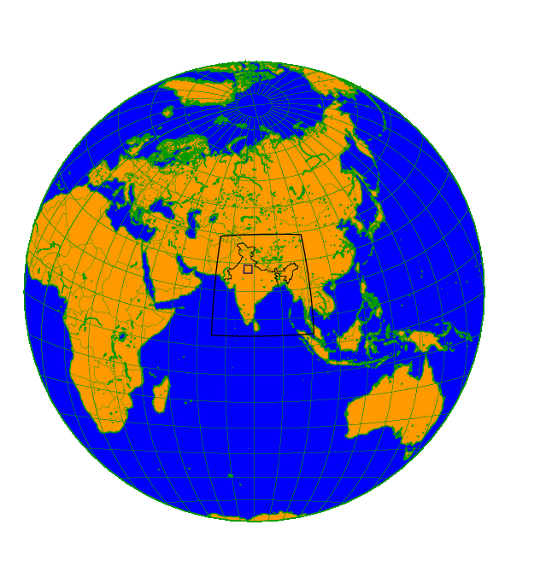
Seamless Forecasting
330 m Delhi Fog Model
1.5 km regional model
up to 48 hr forecast
4 km regional model up to 72 hr forecast
12 km global model
Up to 10 Day forecasts
Global Ensemble Prediction System – 12 km up to 10 Days
Global Atmosphere-Ocean Coupled Model- 38 Km (Seasonal and Extended)
Earth System Model (150 km) Climate Change Projections
Notes:
5
5

Slide 6
MoES has 10 peta flops HPC facility, the largest in the country and fourth best among weather prediction centres in the world
Nov 2017-Feb 2018 (ONGOING)
Brought in a paradigm shift in weather and climate modelling activity for operational weather forecasts
Monsoon Mission : A mission mode program started in 2012 -- to improve Monsoon forecasts skills in the country in all spatial and temporal scales
Achievements
Dynamical seasonal prediction model for monsoons at a very high resolution of 38 kms – operational since 2015
extended range prediction (for next 20 days) useful for dry/wet spells, heat/cold wave etc.
a very high resolution ensemble prediction system at 12 kms in the short and medium range (up to 8 to 10 days), useful for extreme weather prediction.
Total Investment by GoI ~ 10 billion

Slide 7
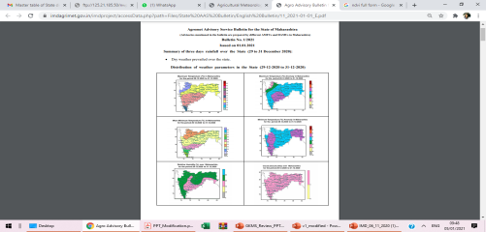
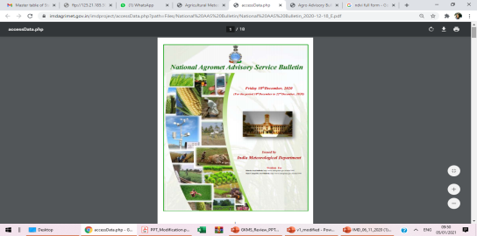
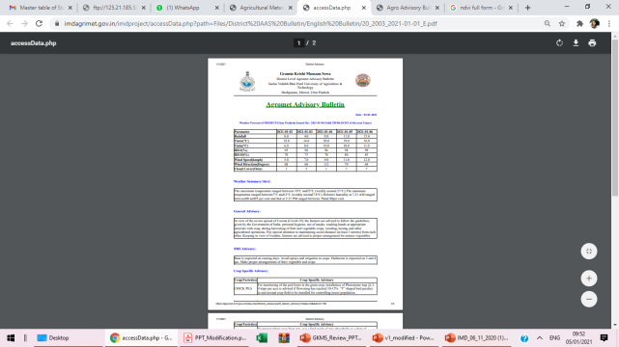
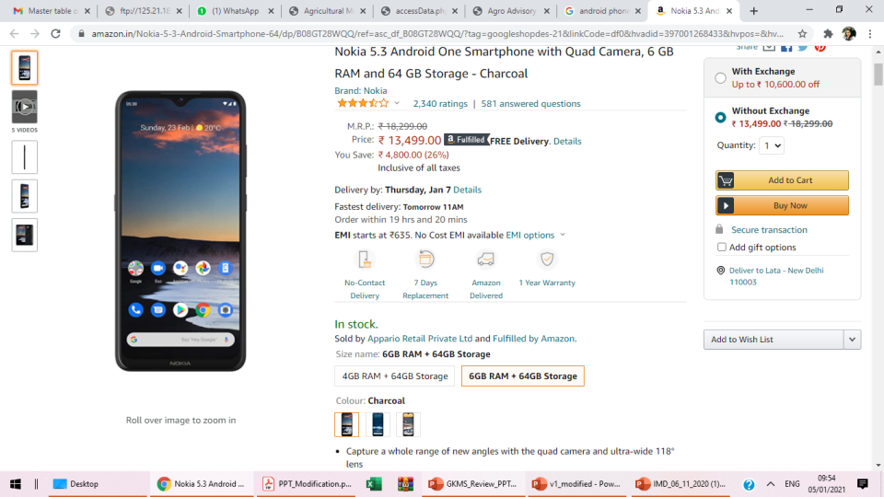

Agrometeorological Advisory Services (AAS) to Farmers
Weather Forecast
Model
Forecast
Rainfall, Temperature,
Wind, Humidity,
Cloud cover
NWP & Satellite Products
Composite State Level Bulletin
State Met Centre
Stakeholders’ Awareness
Composite National Bulletin
Value added forecast at district / Block level for 5 days
Weather based Farm Advisory for all districts in regional languages and ~2300 blocks
Agromet Field Units/
District Agromet Units
Farmers’ Awareness Programme
Multi-Channel Dissemination
Radio, TV, Press, KVKs, State Extension mechanism, Public-Private Partners, Mobile text message (~43.37 million farmers), Mobile Apps, Social media
Economic benefits from savings in farm inputs.
Increased farm productivity and food security.
Training programmes
Feedback mechanism

Slide 8
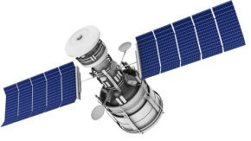
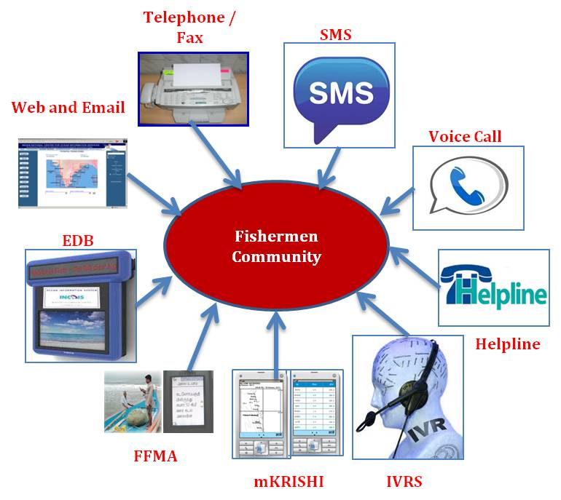

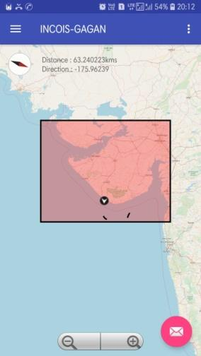


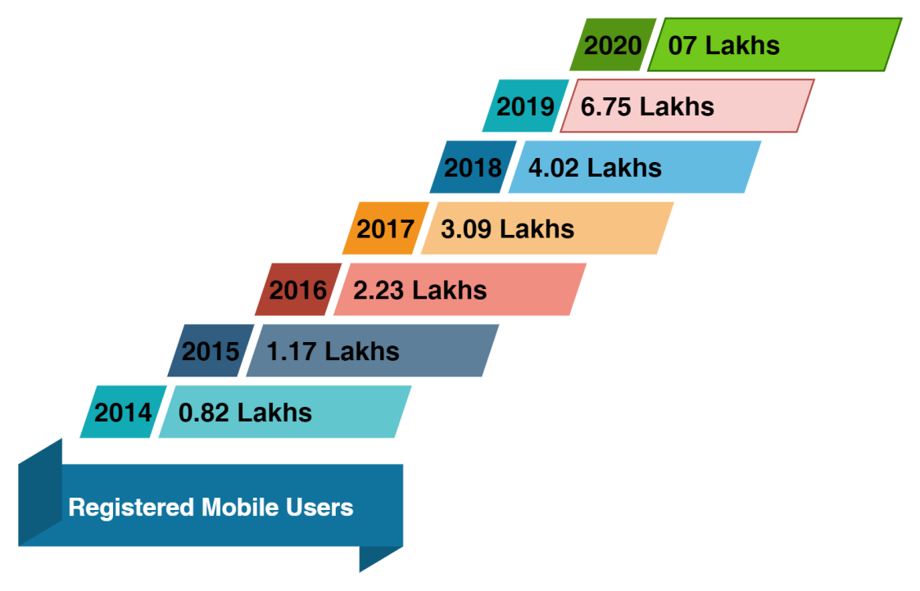

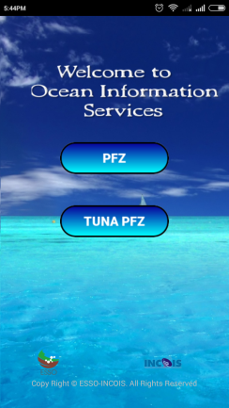
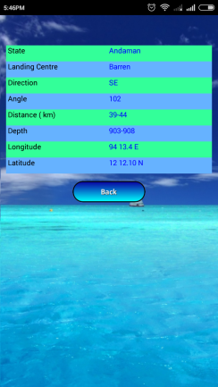
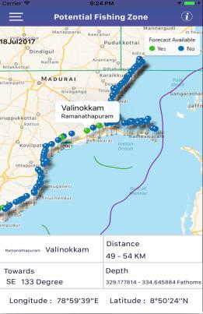
Marine Advisory Service
Satellite based Solution
Potential Fishing Zones (PFZ)
Tuna Fishery Advisories (Tuna PFZ)
Daily Advisories (Map & Text) for 1233 Fishing Villages (exc. Ban & HWs)
Multi lingual advisories in local units
Multilingual SMS directly from PFZ Lab
Advisories contains
  PFZ / Tuna fish locations
  Surface Currents
  Bathymetry
  Indian Coast & EEZ
  Restricted Zones
  Major Fishing Villages
  Maximum fishing Depth (for Tuna PFZ)
Dissemination
GAGAN based GEMINI
Simple & Easy Integration
Economic
Plug & Play
Satellite based Solution
Looking for Ocean Info.
Key role by Mobile based dissemination methods
Active catalyst role by NGO’s and Partner institutes
Annual Economic Benefit
Rs. 34,000 to 50,000 Crore
Additional profit in hands of fishers
Rs 3,000 Cr annuity with investment of Rs.32 Crore
Reaching entire fishermen community
Success : ~ 80%
Per boat Profits
Marine fisheries GDP increase from 3.9% - 7.8 % per annum
Profit: 03–04 times
Less Search Time:30 to 70%
PFZ Mobile App to Ocean Services Mobile App
Growth
0.82 L to 7 L
Multilingual SMS Services
Benefits

Slide 9
Estimating the economic benefits of Investment in “Monsoon Mission” and “High Performance Computing facilities”
A Study Commissioned by
Ministry of Earth Sciences
to
National Council of Applied Economic Research
a non-profit research institution
(2020)

Slide 10
Objectives of the study
To estimate the economic benefits of the investments made in NMM and HPC
To examine the role of improved accuracy of weather prediction in improving the livelihood of farming, livestock rearing and fishing communities
To understand the importance of weather-based advisories in decision making and reducing loss in agricultural households and fishery households
To examine the economic benefits with gender perspective

Slide 11
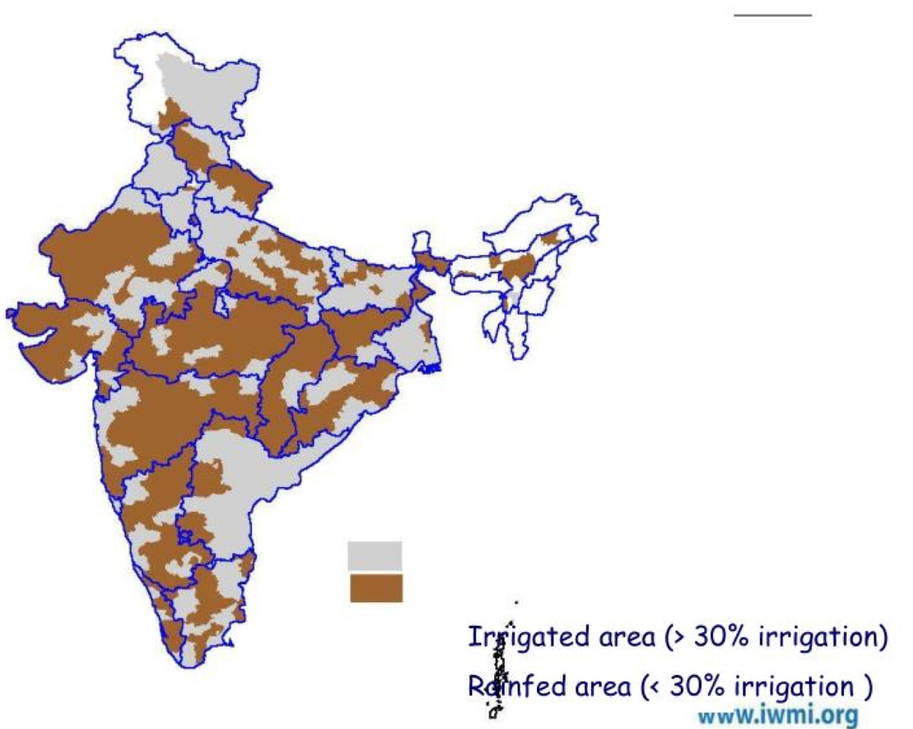

Survey
Primary Data: Reliance Foundation Information Services (RFIS) (Face-to Face survey)
Information on access to weather services – “currently” and “before 2015”
Face-to-face survey of 6098 respondents (3,965 farmers, 757 marine fishermen and 1,376 livestock owners)
Interactive Voice Response Survey (IVRS) of around 0.2 million respondents
Secondary Data: National Sample Survey Organisation -2014, 2017-18
Reference period
Apr 2015 - Mar 2019
173 districts in 16 states

Slide 12
Key findings – survey of agricultural households (farmers and livestock owners)
10.7 million below poverty line (BPL) agricultural households in rainfed areas
3,965 crop farmers interviewed across 121 districts of 11 states of India
1,376 livestock owners interviewed across 92 districts of 10 states of India
Reliability: 94% of farmers and 53.7% of livestock owners are seeking weekly advisory (post NMM) instead of seasonal advisory (pre NMM)
Gain in income/ avoid loss : 80 % of the farmers and 83% of livestock owners who received information on natural calamities reported to have reduced losses occurring due to them

Slide 13
Key findings – survey of agricultural households (farmers and livestock owners)
iii. Adoption of weather advisory in critical practices
98% farmers* and 76% of live stock owners# made modifications to at least one of the critical practices based on the weather advisories & had income gain
Average annual income of farming households which adopted no modification worked out to be 0.2 million ; 0.3 million for those who adopted all the nine changes.
96% livestock owners reported that weather advisories help in improving the practice of vaccination against seasonal disease.
*changed variety/breed; arranged for storage of harvest; early/delayed harvesting; changed crop; early/delayed sowing; changed schedule of ploughing/land preparation; changed pesticide application schedule; changed fertilizer application schedule; and changed scheduled irrigation
# modification of shed/shelter; vaccination against seasonal disease; and fodder management

Slide 14
Key findings - Fishermen
0.53 million below poverty line (BPL) fisherfolk households
757 marine fishermen across 34 districts in 7 states of India
82% fishermen use OSF advisories before venturing into sea
95% of them reported to have avoided empty trips by following OSF advisories, which helped them save 182.5 million of operational cost
87.7% of fishermen using these advisories on daily basis, as compared to just 15.1% before 2015
19.2 million additional income was generated from the 1,079 successful fishing expeditions made using the Potential Fishing Zone Advisories
About 97% of the fishermen received information about flood or cyclone on time and about 86% were able to minimize their losses due to this.

Slide 15
Estimation of Economic Benefits
Key results
Economic benefits of agricultural households (farmers and livestock owners taken together) works out to be 480.56 billion over a period of 5 years
Economic benefits of fisher households is estimated to be 23.91 billion over a period of 5 years
26.6 % of the total benefits is attributed to women contribution
Total economic benefit is 504.47 billion over a 5-year period
An initial investment of ~ 10 billion, NMM and HPC facilities result in a 50-fold increase in its economic benefits

Slide 16
Thank you

Slide 17

PROGRAM TO SUPPORT SOUTH ASIA REGIONAL DEVELOPMENT IN OPERATIONAL FORECASTING AND SERVICE DELIVERY
SAHF Website: https://sahf3event.rimes.int/
YouTube Broadcast:
https://youtu.be/QAAf326wP00

