Slide 1

Evolving protocols & support systems for impact-based forecasting
SATARK : Impact Forecast System
ARABINDA RAY
System Expert
Odisha State Disaster Management Authority

Slide 2
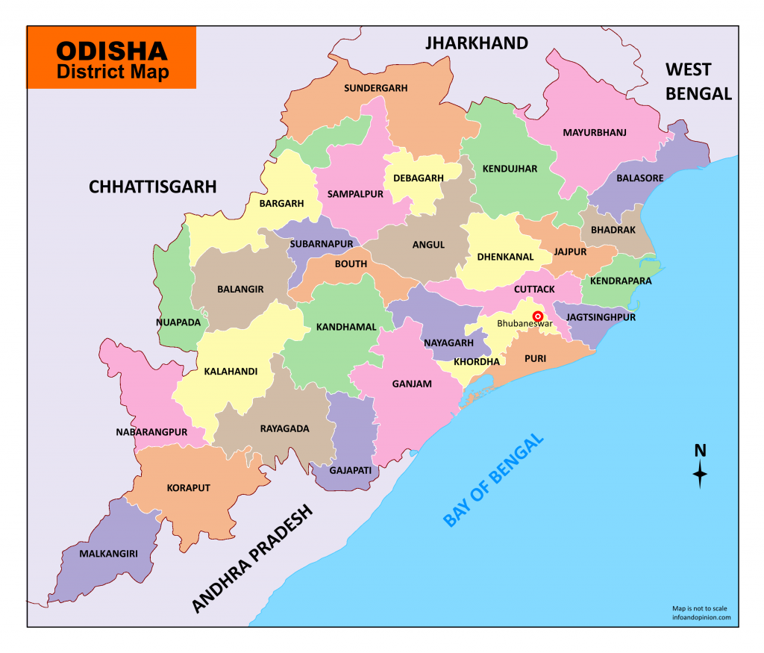
OSDMA: Odisha State Disaster Management Authority
Odisha, formerly called Orissa, state of India, located in the northeastern part of the country and eastern seaboard of India
The geo-climatic conditions make almost the entire State vulnerable to different disasters
The state is one of the most disaster prone area in the country with a 480 Kms of coastline frequently affected by cyclones
Eleven major river systems creates frequent floods. Lightning, heatwaves droughts are also of serious concern
About two-third of the total cultivated area being rain-dependent, drought poses a serious threat at regular intervals in the event of failure of Monsoon
Some part of the state comes under Earthquake Risk Zone-III (Moderate Damage Risk Zone) covering 44 out of the 106 urban local bodies with Tsunami also a potential hazard for the State

Slide 3
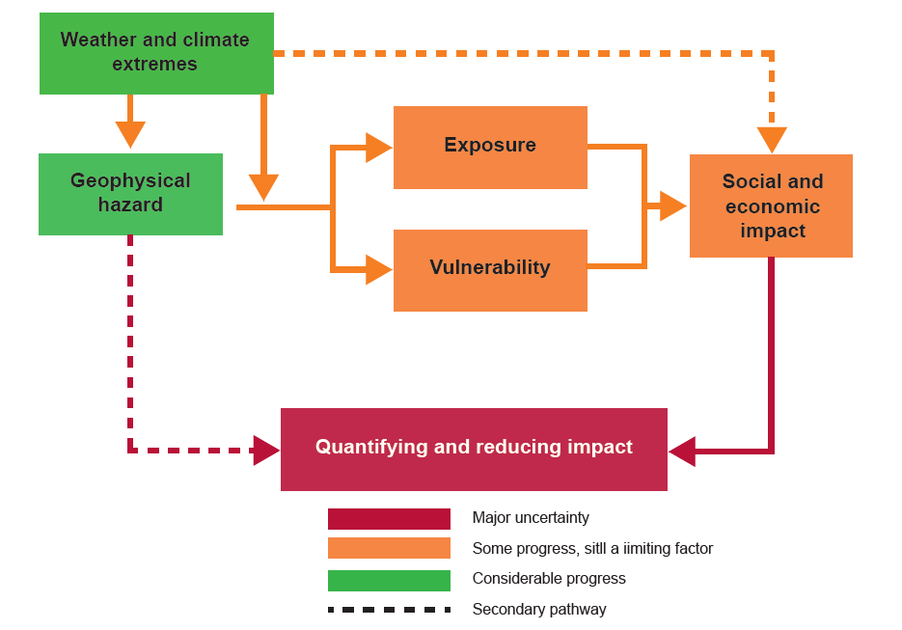
Impact – Based Forecasting for Early Action
Impact-based forecasting provides the information needed to act before disasters to minimize the socio-economic costs of weather and climate hazards.
Organizations and individuals can make critical decisions to ensure that resources and supplies are in place to take early action and to respond as soon as it is safe to do so.
Flash floods, floods, landslides, cyclones and drought, in particular, give rise to multiple casualties and significant damage to livelihoods and property.
In order to significantly reduce losses, communities and individuals need to be more resilient through actions that integrate weather and climate information in decision-making.
IBF should provide information
  Population at risk
  Agriculture area at risk
  Livestock at risk
  Expected economic damage
  Inundation area
  Safety measures

Slide 4
For Developing an Impact-based Forecast System
Monitoring and Early Warning
Develop hazard monitoring and early warning services
Are the right parameters being monitored?
Can accurate and timely warnings be generated?
Dissemination and Communication
Communicating risks and early warnings .
Do warnings reach those at risk?
Is the warning information clear and actionable?
Response Capability
Build national and community response capabilities
Are response plans up to date and tested?
Are people prepared and ready to react to warnings?
Assessing Risks
Are the hazards and the vulnerabilities well known?
Are risk maps and data widely available?

Slide 5
SATARK
(System for Assessing, Alerting & Tracking Disaster Risk Information based on Dynamic Risk Knowledge )
In collaboration with Regional Integrated Multi hazard Early warning System for Africa and Asia (RIMES)."SATARK” a one-stop risk management portal, has been developed using cutting edge technologies to provide actionable early warning information for improved disaster management.
Heat wave & Cold wave
system
Flood Forecast System
Road Safety Monitoring System
The system translates weather forecast products into user-friendly actionable advisories, based on thresholds drawn from historical patterns, to ensure effective preparedness in place to minimize the risk.
Onestop risk management portal
SATARK
Agriculture/
Drought Monitoring System
It offers impact-based forecasting, which drives actions to save lives, protect property, and livelihoods.
Lightning Advisory System
Cyclone Monitoring System
SATARK is a web/smart-phone based Decision Support System that aids in provision of timely early warning information for different hazards. The mobile application is available in both Odia (regional language) and English languages.
Earthquake & Tsunami Monitoring System
Ocean State Information System

Slide 6
SATARK: Framework for Impact based forecast and Warning service
Understand Warning Needs for Early Actions
Build Partnerships and Collaborations
An institutional framework between stakeholders like DOA, DOWR for data and service
Access Forecast Products
SATARK integrates forecast products from primary sources like India Meteorological Department (IMD), European Center for Medium range weather forecast (ECMWF) and SRC observations were also integrated
Analyse/Compute Hazard Intensity (extremes)
Integrate Local Datasets (roads, infra)
SATARK assesses the impacts of the forecasted climate and weather phenomenon and generates the warnings based on the level and severity of impacts using defined thresholds
Assess Risk (Hazard x Vulnerability x Exposure) and potential impact
Generate Impact information/alerts/advisories
Disseminate with ample lead time
Early warning information disseminated through mobile application, automatic email advisories, SMS services and receive feedback through the app
Receive Feedback

Slide 7
Case Study: Impact Forecast Results for Cyclone FANI
Based on the assigned model forecast the system automatically identifies the vulnerable regions which are to be effected by the cyclone.
The impact has been assed based on the severity of the storm.
The Brown color indicates regions with a Low level of Alert.
The Yellow color indicates regions with a Moderate Level Alert..

Slide 8

PROGRAM TO SUPPORT SOUTH ASIA REGIONAL DEVELOPMENT IN OPERATIONAL FORECASTING AND SERVICE DELIVERY
Thank you
SAHF Website: https://sahf3event.rimes.int/
YouTube Broadcast:
https://youtu.be/QAAf326wP00

