Slide 1
Improving weather and climate forecasts for the region
SAHF program design to meet challenges and harness opportunities in the coming decade
Shiromani Jayawardane,
Director, Weather Forecasting and Decision Support,
Department of Meteorology, Sri Lanka

Slide 2
CHALLENGES AND OPPORTUNITIES
SA - most densely populated geographical region in the world.
70-80% of the total annual rainfall occurs during the monsoon and the monsoon greatly affects the socio-economic sectors of the countries of this region
Seasonal to inter-annual variability of monsoon rainfall,, often results in severe droughts or floods, with large-scale impacts on the agrarian societies in terms of agricultural production and food security.
Lack of observational data especially over Ocean area and Data sharing issues

Slide 3
Improving weather and climate forecasts for the region
Progress in seamless prediction from short range, sub seasonal, seasonal to climate change projections but not much progress in decadal predictions
Operational weather forecasting based on numerical prediction systems has continuously improved over the past few decades - local and urban scale impact based forecast
Expansion of observations network including“non-conventional” observations
Importance of Research - Understanding the monsoon process, cross timescale interactions, tropical-extra tropical interactions, prediction and predictability of the monsoon, and monsoon variability etc
Tailored Forecasts for user requirements

Slide 4
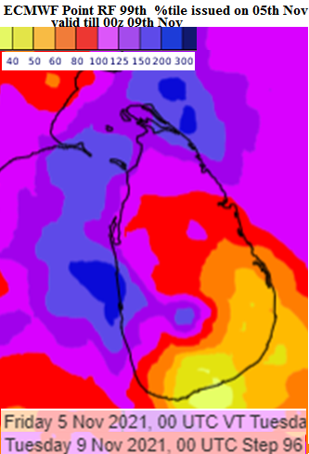
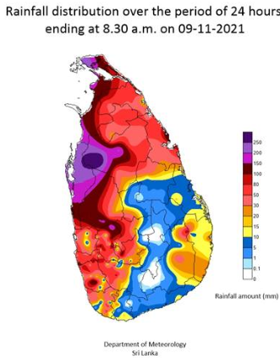
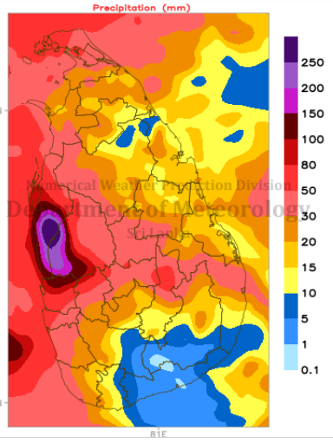
ThIS EVENT was WELL PREDICTED BY MODELS , TIMELY WARNINGS ISSUED HOW EVER At least 20 persons have died and over 17,481 people have been affected due to the adverse weather conditions in many parts of Sri Lanka (07-09 Nov).
Point RF Fc 3 days before
Ensemble Fc on 08th 00z valid till 00z 09
Observation

Slide 5

PROGRAM TO SUPPORT SOUTH ASIA REGIONAL DEVELOPMENT IN OPERATIONAL FORECASTING AND SERVICE DELIVERY
SAHF Website: https://sahf3event.rimes.int/
YouTube Broadcast:
https://youtu.be/QAAf326wP00

