Slide 1
SESSION 3: Improving weather and climate forecasts for the region
Evolution of the Global Weather Enterprise
Alan Thorpe

Slide 2
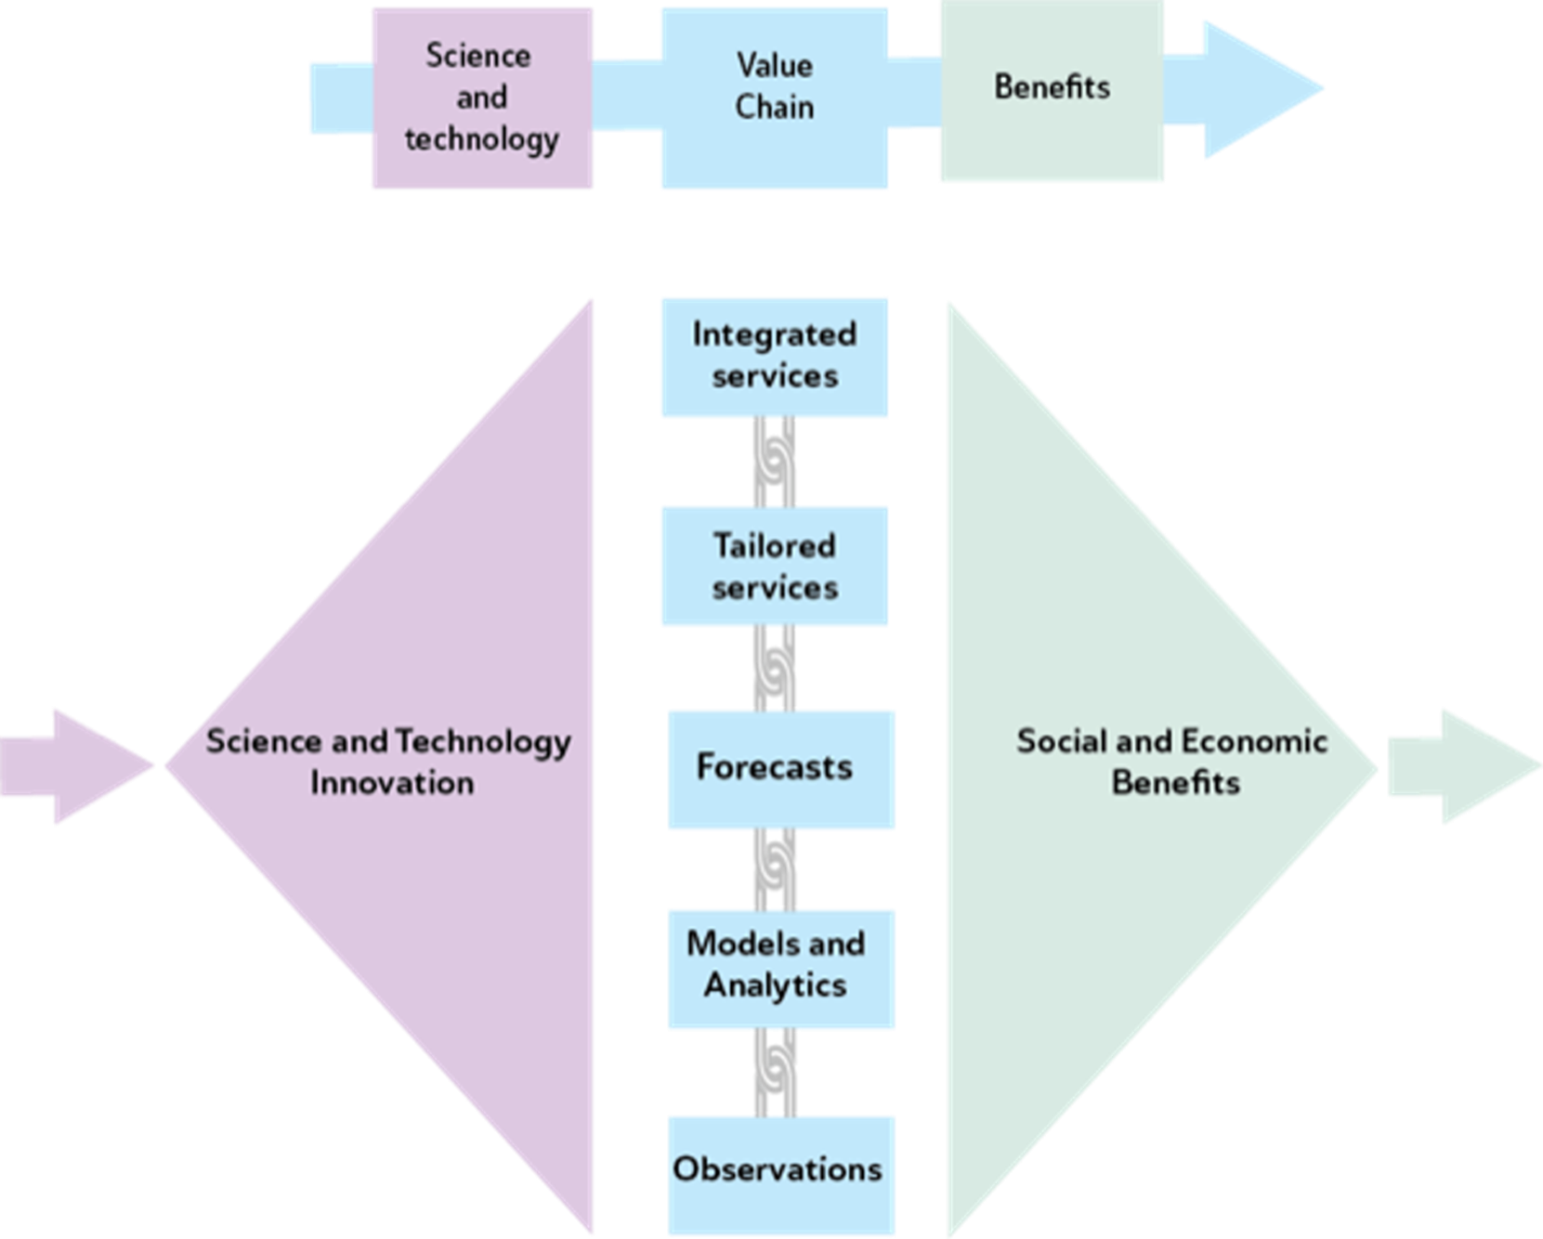



Slide 3

Miniaturisation of satellites; filling gaps in sfc-based observations; IoT observations
Higher resolution NWP; fully coupled Earth system models and digital twins
Use of ML/AI in NWP and in services
Digital data access via “weather clouds”

Slide 4
Evolution of Hydromet Services
Impact-based forecasts stepping towards fully “integrated services”
Forecasting risks and economic/business opportunities – the “new economy”
Capabilities of the private sector increasing

Slide 5

INTEGRATED SERVICES
Operational decision-to-act
Merging digital data and analytics on all factors
Other factors that influence a decision-to-act
Tailored (“impact-based”) Hydromet forecast
“Outcome” sensitive to Hydromet

Slide 6
Delivering Hydromet Services
Requires:
national capacity and capability to access and use digital hydromet data from new global weather-clouds
more global, regional and national collaboration across the public sector and with the private sector
better integration across national institutions

Slide 7

PROGRAM TO SUPPORT SOUTH ASIA REGIONAL DEVELOPMENT IN OPERATIONAL FORECASTING AND SERVICE DELIVERY
SAHF Website: https://sahf3event.rimes.int/
YouTube Broadcast:
https://youtu.be/QAAf326wP00

