Slide 1
Session 4: Prioritizing training and capacity development requirements
Contribution to SAHF priorities: India Meteorological Department (IMD), Regional Training Center, Pune
Somenath Dutta, IMD

Slide 2
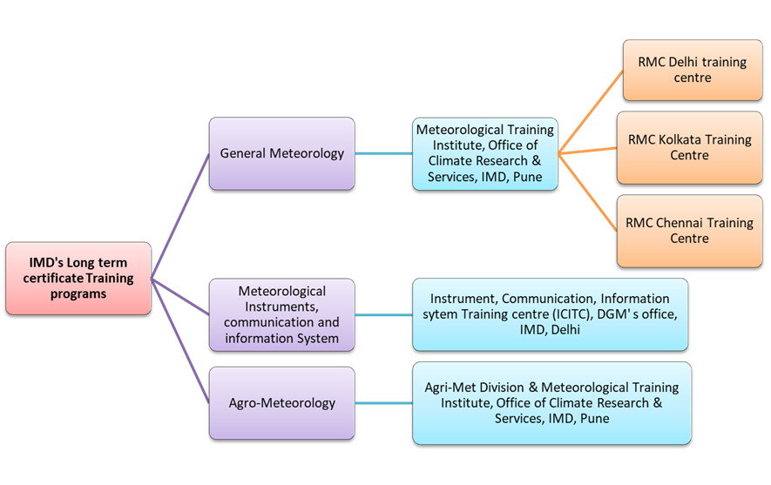
Role of RTCs, owned by IMD in the capacity development in the region
Conducting long-term certificate (WMO BIP-M & MT) training courses in General Meteorology, Agriculture Meteorology and Instruments & telecommunication disciplines.
Designing & conducting customized tailor-made short-term training modules on subjects/topics of topical interests.
Announcements of all courses are made well in advance over WMO Global campus.

Slide 3
Difficulties
  Lack of desired number of overseas participants, even from the region itself.
  Many times right participants are not nominated, may be due to lack of a proper training needs assessment
  Hardly Stakeholder’s feedbacks are received

Slide 4
How RTCs, owned by IMD, can assist?
In addition to announcement over WMO GC, Chiefs of NMHS in the region may be requested to nominate suitable participants for a specific capacity building training program.
Assist in regional training need assessment.
Designing, conducting short term tailor made training programs /workshop on extreme weather events, impact based weather services, weather & climate services on societal sectoral sectors, etc., as per the regional requirements.
Assisting in R&D work on climatic influence on VBD, identification of local TW for VBD.

Slide 5
Thank you
SAHF Website: https://sahf3event.rimes.int/
YouTube Broadcast:
https://youtu.be/QAAf326wP00

